Slide 1


Slide 2
AWS Elastic Beanstalk
The AWS Elastic Beanstalk is a cloud deployment service by which you can easily set up your application on the Amazon Web Services infrastructure simply by just uploading it.
All the other necessary operations like autoscaling, provisioning, load balancing, and application health monitoring will be handled automatically by using it.

Slide 3
AWS Elastic Beanstalk
Elastic Beanstalk is blessed with an open architecture, which means that even the applications not written for the web can be deployed on it.
Amazon doesn’t charge additionally for the Elastic Beanstalk, consumers will just have to pay for the resources used to run and store their apps.

Slide 4
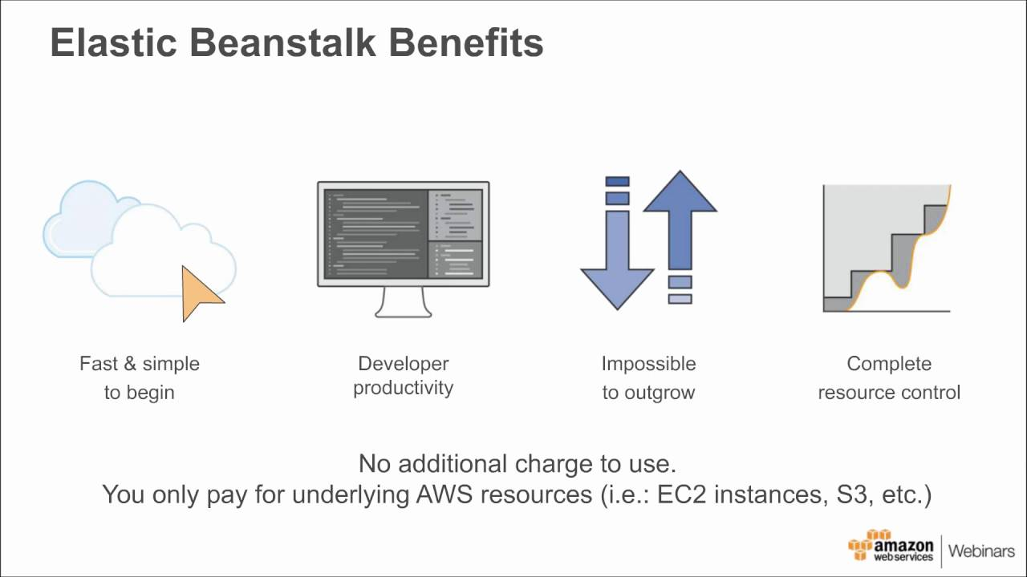

Slide 5
AWS Features
Application Support
Amazon Elastic Beanstalk offers you support for a wide range of application environments.
It supports a lot of container and coding platforms including Ruby, Python, Node.js, PHP, .NET, JAVA, and Docker.

Slide 6
AWS Features
AWS Integration
Elastic Beanstalk comes with the availability of native and deep integration with the rest of the Amazon Web Services.
It means that you are allowed to configure your application according to your requirements.
You can perform a lot of actions with the help of it, like enabling SSH access, choosing different instance types with more or less memory, arranging the required security, and connecting with additional AWS services such as RDS, Lambda, and S3.

Slide 7
Scalability
With the help of Elastic Beanstalk, you can have a small start and can scale it up to desired heights.
Amazon gives you the power to create 75 apps on the Elastic Beanstalk, with 1000 versions of each one of them.
All the users are allowed to run up to 200 environments across each and every one of their applications by default.
Moreover, you are also allowed to request more using a request form if your organization needs more resources.
Provisioning
The AWS Elastic Beanstalk comes with an ability of provisioning all the load balancers, necessary instances, and additional resources that your application requires.
So, you don't have to worry about anything as the Elastic Beanstalk will take care of every necessity of an application.
Furthermore, you don’t even have to specify anything related to the type and size of these resources.

Slide 8
AWS Features
Versioning
Easy version management of applications is also a great facility offered by the Elastic Beanstalk.
With the help of EB (Elastic Beanstalk), you can easily deploy different application versions to a running environment of an application. Moreover, you will also not face any hurdle while rolling back to a previous version of that application.

Slide 9
AWS Features
Monitoring
While running an application in production, it is highly important to know if any issue arises, so that you can fix it at the right time.
The Elastic Beanstalk checks it out for you by executing regular health check-ups to ensure the smooth running of your application.
If not, the EB finds out the root cause of the problem and resolve it within a very small period of time.
For this, the Elastic Beanstalk may launch a new instance, which is failing, or replaces the load balancer if the issue is being caused by it.

Slide 10
AWS Features
CloudWatch
With the help of Elastic Beanstalk, you also get access to the Amazon CloudWatch.
By using this marvelous management tool, you can monitor the system environment via set metrics such as CPU usage, inbound/outbound network traffic, and request count.
It will provide you the exact measurement of your application’s health status.

Slide 11
AWS Features
Management
By using the AWS Elastic Beanstalk, you can easily take the guesswork out of managing your currently running application.
You are allowed to administer the versions and environments of your application via Beanstalk console.
You can also view logs, restart instances, and even rebuild the entire infrastructure with the help of AWS Elastic Beanstalk.

Slide 12
AWS Features
Automatic Scaling
If your application runs smoothly at a server but causes distortion sometimes, it means that you will need two or three servers to scale it up.
You can perform this task with ease if you are using the AWS Elastic Beanstalk.
You can set triggers to add or remove instances depending on a load of your application.
In simple words, you can increase the number of servers if the CPU usage goes above 50 percent.

Slide 13
AWS Features
Notifications
If you are using the AWS Elastic Beanstalk, you will get notifications automatically whenever improvement events and activities take place for your application.
For example, you will get notified when new deployments occur, new servers are launched, or your predefined threshold is suppressed.

Slide 14
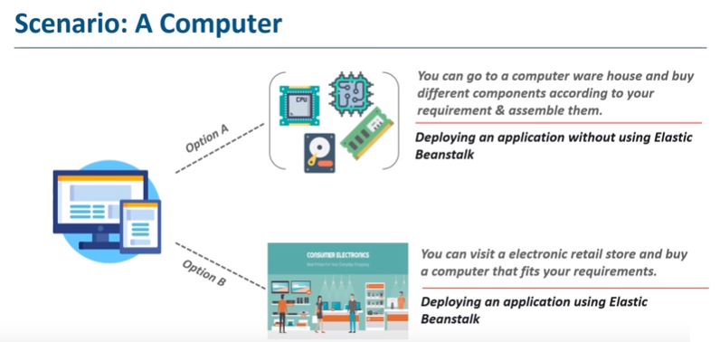

Slide 15
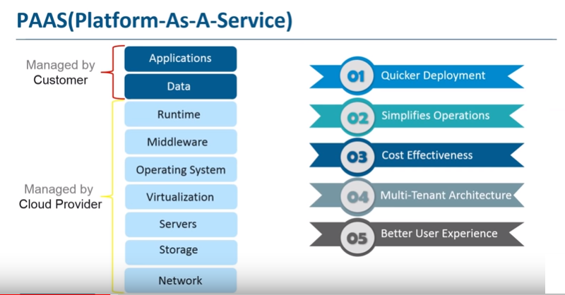

Slide 16
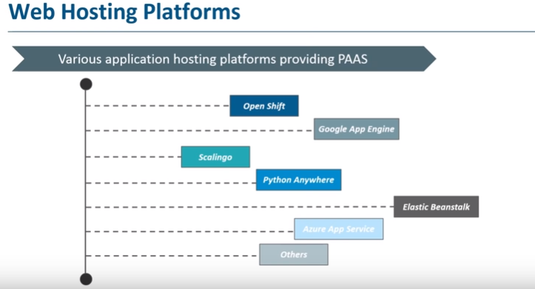

Slide 17
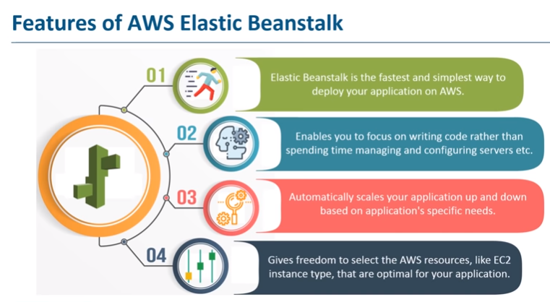

Slide 18
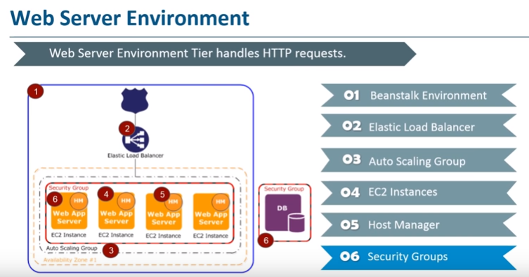

Slide 19


Slide 20
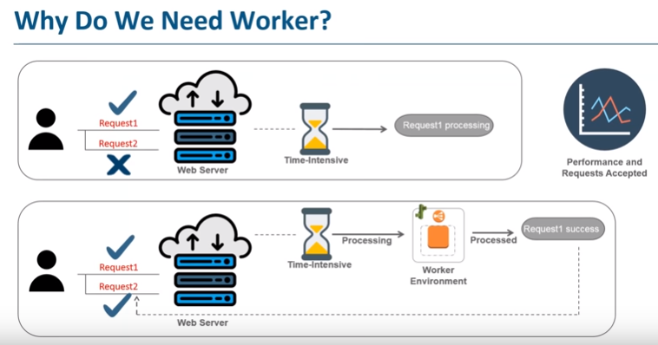

Slide 21
Practical of AWS Beanstalk

Slide 22
Code Spring Boot Rest Application
Make A Spring Boot Rest Application
Right Click on project -- Run as -- Maven build -- Under Goals "install" -- apply --run
It will make a .jar file under target folder.

Slide 23
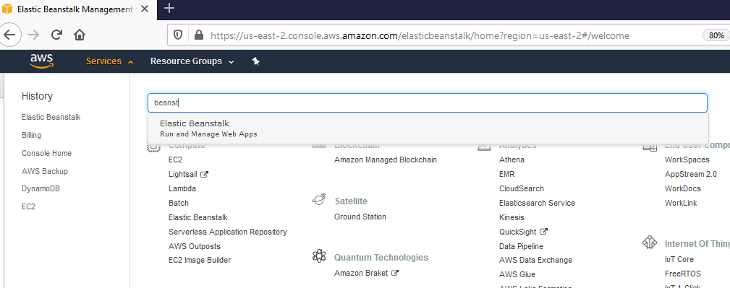

Slide 24
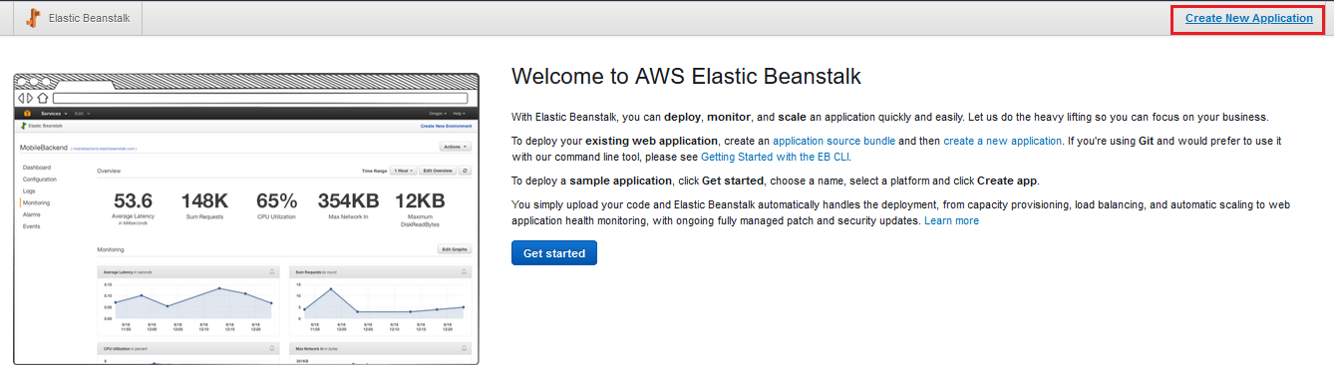

Slide 25
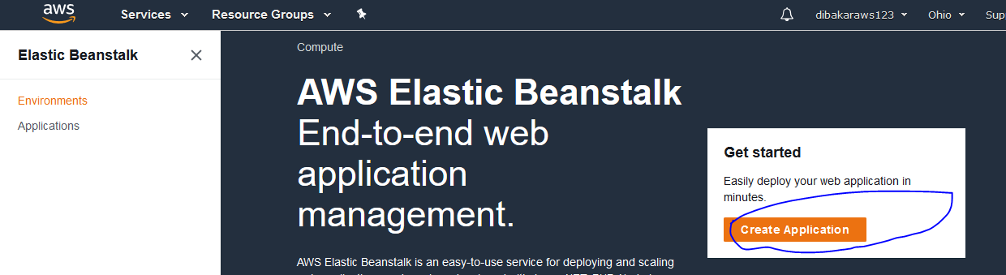

Slide 26
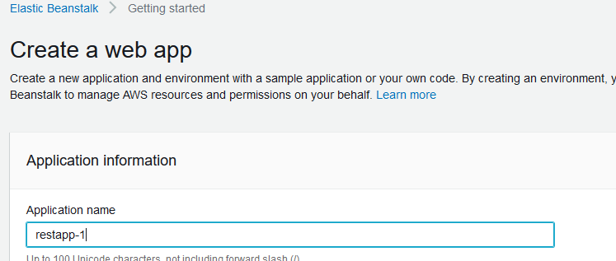
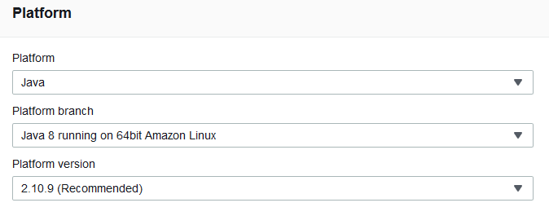

Slide 27
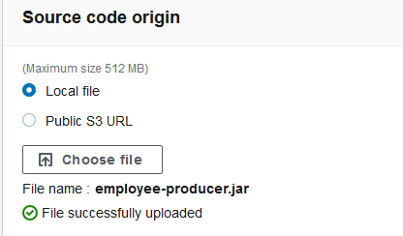

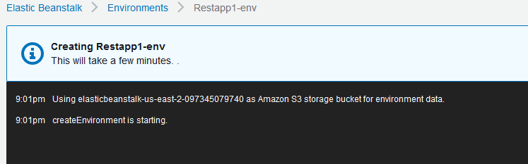

Slide 28
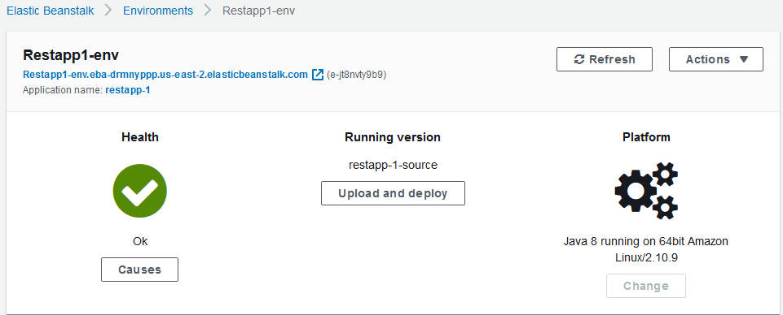

Slide 29
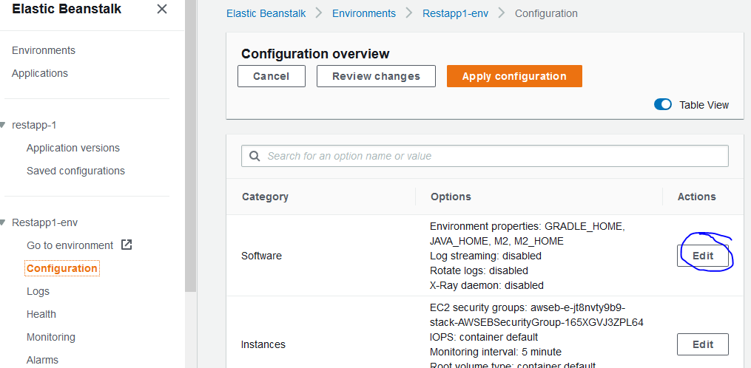
Check configuration

Slide 30
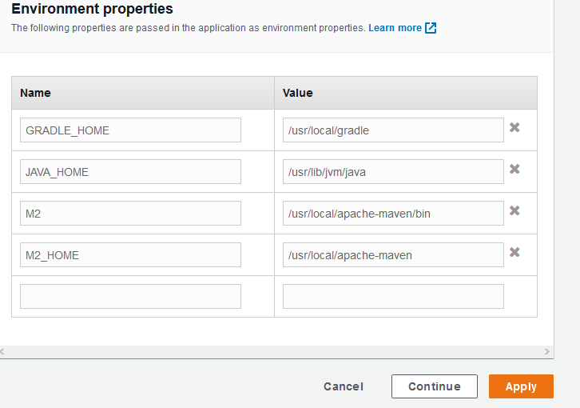
Check configuration

Slide 31
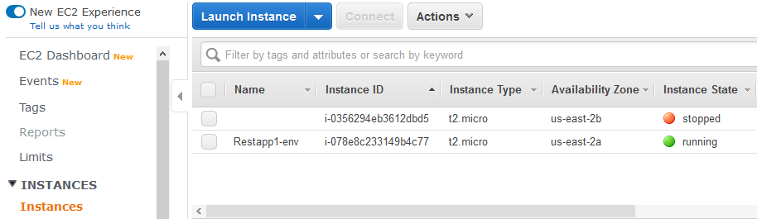
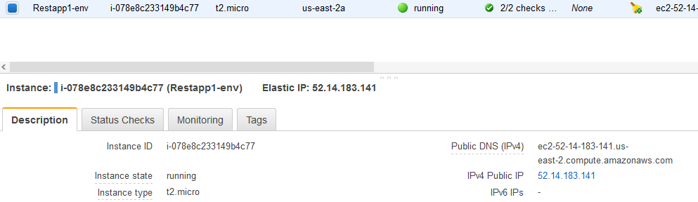
Now Check EC2 Instance & its IPv4 address

Slide 32

Now Test Spring Boot Rest APIs from web browser
Provides error:
Now need to click on Security Groups under instance :

Slide 33
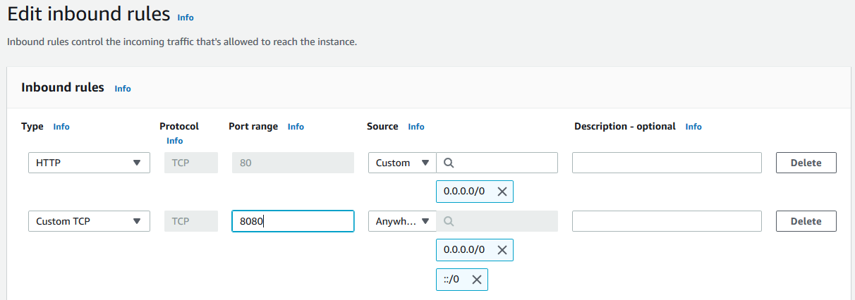
Now Test Spring Boot Rest APIs from web browser

Slide 34
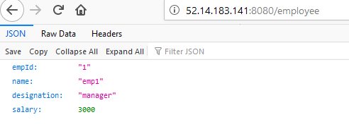
Now Test Spring Boot Rest APIs from web browser

Slide 35
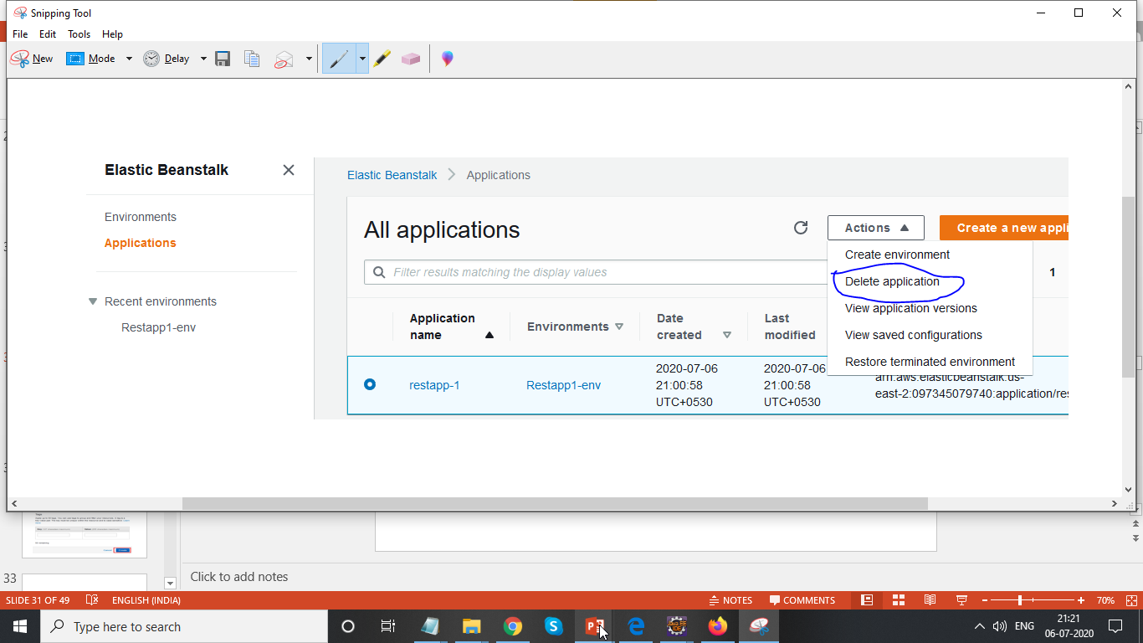
Now Test Spring Boot Rest APIs from web browser

